Slide 1
TITLE: ROBOT BASED AUTOMATION FOR VERTICAL FARMING
PROJECT PROPOSAL PRESENTATION
Poola Rohith | B180712ME
Akondi Sai Manoj | B180161ME
Mamidi Thejonath | B180129ME
Kuraganti Vedantham | B180473ME
Guide
Dr. Sudheer A P
Assistant Professor
Mechanical Department
Co-Guide
Dr. K Sekar
Assistant Professor
Mechanical Department

Slide 2
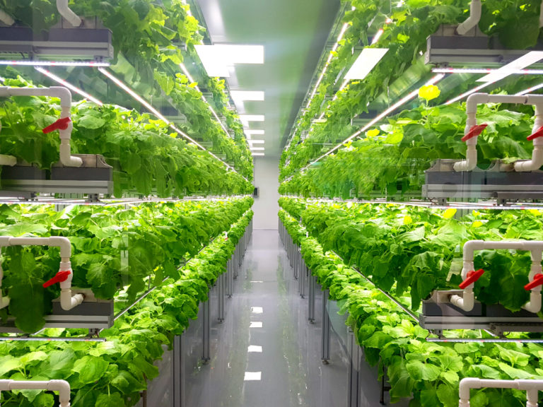
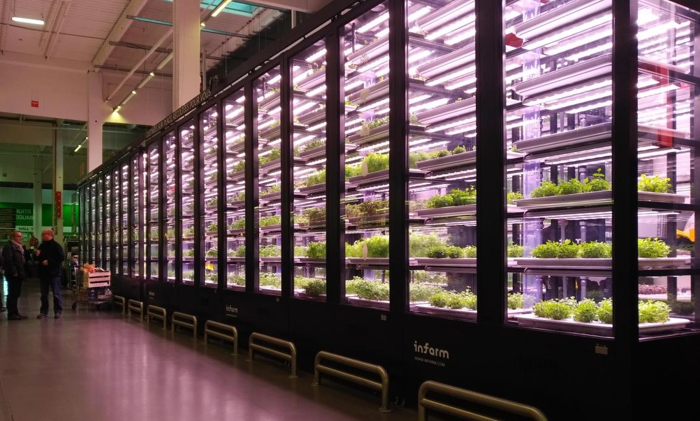
Introduction to Vertical Farming
Vertical farming is the practice of growing crops in vertically stacked layers
It aims to optimize plant growth and yield by soilless farming techniques (hydroponics).

Slide 3
Objectives
The objective of this project is to develop a robot-based automation system for vertical farming, which includes:
Development of Autonomous 4 DOF serial robotic manipulator.
Automation of vertical farming at domestic level for minimizing human intervention in farming and reducing the utilization of water.
To maintain control of the parametric conditions of crop environment such as humidity, temperature, air ventilation etc.

Slide 4
Significance of the work
One of the best way of soil less farming which is both space and water efficient.
In regular farming 67% of water is being wasted where as Vertical farming (Hydroponics) requires 90% less water comparatively.
Automation is more reliable and feasible in vertical farming

Slide 5
Methodology
Robot design and fabrication
Fabrication of farming table and lift
Control environmental parameters and setup
Control of water and hydroponic supply to the crops
Complete automation vertical of farming

Slide 6
Work Plan
DEADLINES
Finalizing Project Idea
30 – JUN – 2021
Conceptual design, selection and optimum design.
30 – SEP – 2021
ACTIVITY
Virtual simulation
30 – NOV – 2021
Prototype Fabrication and Assembly of complete system
31 – JAN – 2022
Control and Automation
31 – MAR – 2022

Slide 7
Expected Outcomes
Well designed and fabricated vertical farming system using hydroponics.
Fully automated pipeline which involves minimum/no human intervention.
The prototype developed can be easily accommodated in houses and an Eco-friendly appliance.
Planning to apply patents for the innovation or publishing Journal paper.
Notes:
http://www.nitc.ac.in/res_cons/Guidelines_2021.pdf

Slide 8
Budget with justifications
Items required | Amount | Justification based on the outcome expected
G.I pipes | 3000 | Table & lift frame
Aluminum extrusions | 5000 | Table frame
Wood floor | 1000 | Table base
PVC parts | 1000 | Planting environment & Water storage
Couplings, Leadscrews | 2000 | Manipulator & lift
Hydroponics | 10000 | Nutrient solution
Notes:
Prepare the budget with stringent control that can be exercised to have minimal use of fund for achieving the objectives. Please remember that the money is internally generated revenue and hence very sparingly to be used. Guide(s) have to take utmost care while preparing/finalising the budget.

Slide 9
Budget with justifications
Items required | Amount | Justification based on the outcome expected
Motors | 24000 | Manipulator, lift
Motor drivers | 10000 | Motors used
PCB | 4000 | -
Camera | 5000 | Vision & Inspection
Jetson Nano | 10000 | Computation
Other consumables | 5000 | Fabrication
Contingency | 20000 | -
TOTAL | 100000
Notes:
Prepare the budget with stringent control that can be exercised to have minimal use of fund for achieving the objectives. Please remember that the money is internally generated revenue and hence very sparingly to be used. Guide(s) have to take utmost care while preparing/finalising the budget.

Slide 10
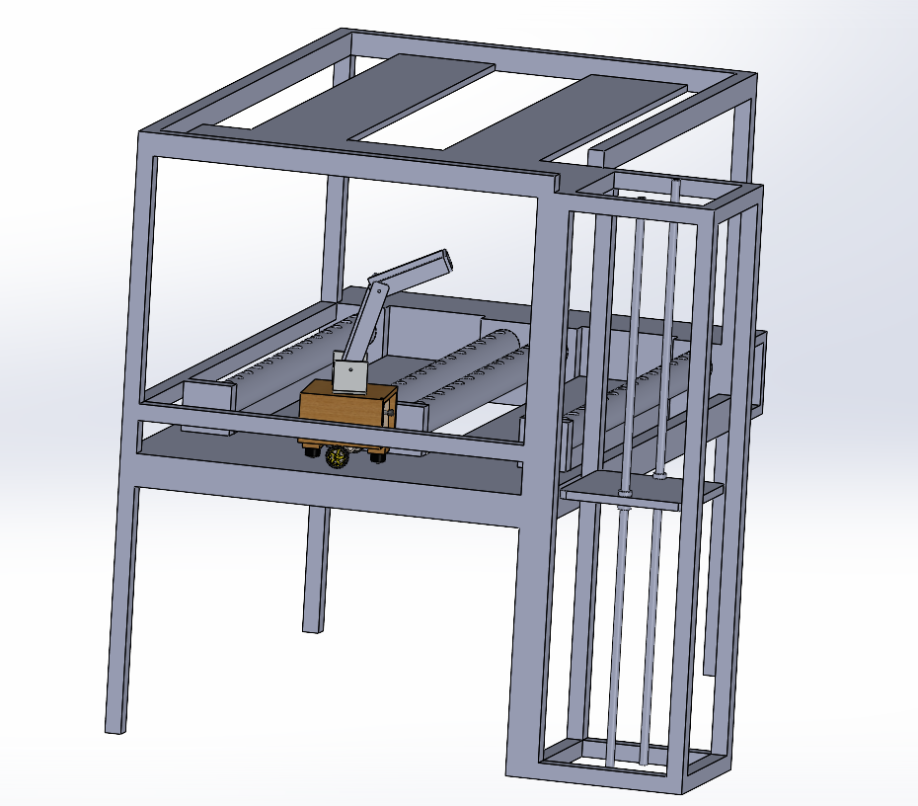
Project Overview
Notes:
Prepare the budget with stringent control that can be exercised to have minimal use of fund for achieving the objectives. Please remember that the money is internally generated revenue and hence very sparingly to be used. Guide(s) have to take utmost care while preparing/finalising the budget.

